Slide 1
[ MPMC PROJECT — B.TECH COMPUTER ENGINEERING | SEM IV ]
COURSE
Real-Time Stock
Microprocessor &
Microcontroller
Signal System
702CO0C072
Arduino Mega 2560
using Arduino
Python Dashboard
8051 Assembly
NSE Backtesting
7-Layer Architecture
EMA · RSI · Bollinger Bands · MACD | ATmega2560 Edge Computing
Lucky Ansari (B296)
Faculty: Prof. Sachin Sonawane | SVKM's NMIMS MPSTME Shirpur | AY 2025–26
Wokwi Simulation + NSE Nifty 50 Validation

Slide 2
Problem Statement & Objectives
Why this project matters — and what we set out to prove
THE PROBLEM
OUR OBJECTIVES
Cloud Latency
1
Design interrupt-driven real-time embedded system on Arduino Mega 2560
Real-time signal analysis fully dependent on massive cloud infrastructure
2
Map MPMC theory: Timer CTC, INT0, PWM, UART, Watchdog, EEPROM
No Hardware Intuition
Zero physical hardware performing financial math — purely software-based
3
Write UART module in pure 8051 Assembly to validate CO3
No Backtesting
4
Build Python dashboard with Matplotlib for hardware telemetry
Embedded projects never validated mathematically against real market data
5
Mathematically prove logic via 6-month NSE Nifty 50 backtesting
SOLUTION: Industrial-grade 7-layer embedded architecture computing financial indicators directly on ATmega2560 in real-time

Slide 3
7-Layer System Architecture
Professional software-hardware co-design pipeline
L7
Representation Layer
HARDWARE
Custom LCD chars · PWM RGB color mixing · Buzzer melodies
L6
Protocol Layer
HARDWARE
ADC · External Hardware Interrupts (INT0) · Timer-driven dispatch
L5
Processing Layer
BRIDGE
Composite Engine (EMA + RSI + BB + MACD) on ATmega2560
L4
Communication Layer
BRIDGE
Bidirectional UART JSON Payload over Serial @ 9600 baud
L3
Data Feed Layer
SOFTWARE
Geometric Brownian Motion (GBM) volatility simulator via ADC
L2
Dashboard Layer
SOFTWARE
Real-time Python Matplotlib 4-panel animation
L1
Validation Layer
SOFTWARE
Python Backtesting Engine · Sharpe Ratio on 6-mo NSE data

Slide 4
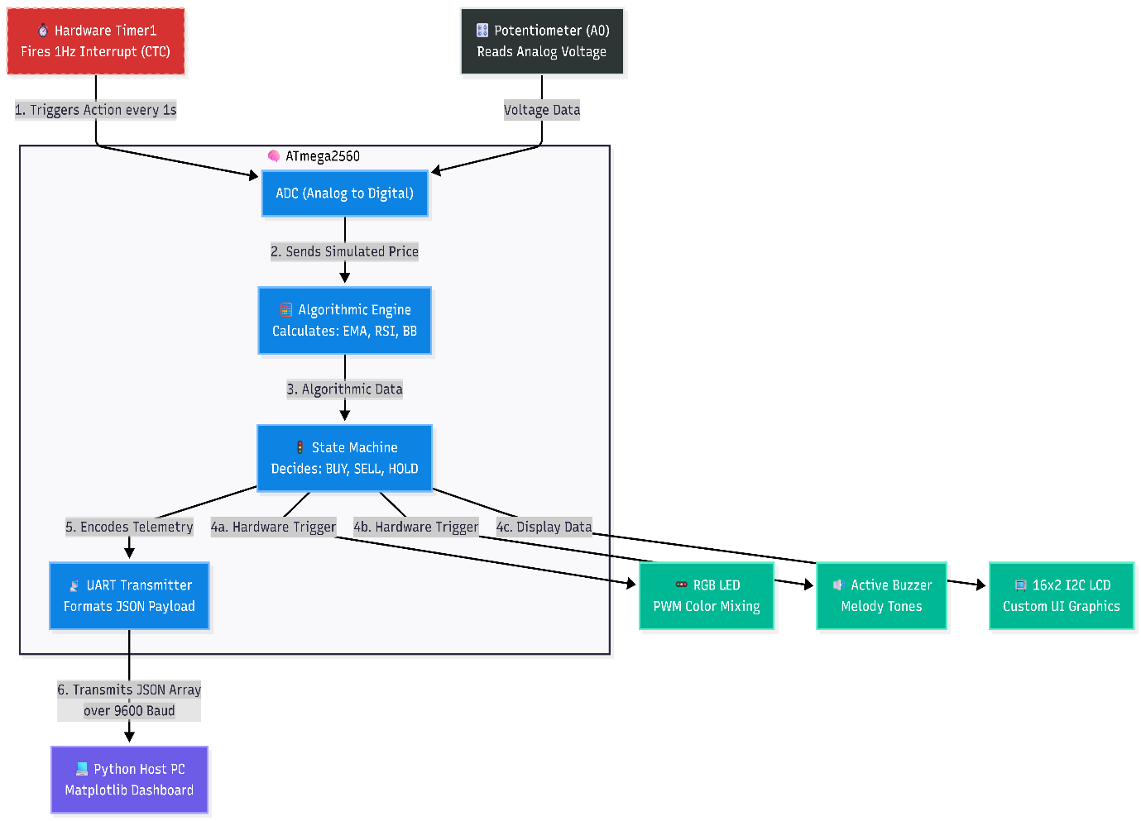
System block diagram detailing data flow between the ADC, MCU, and Python Host.

Slide 5
Components Used
Hardware selection rationale for embedded FinTech edge computing
⬡
▤
⊙
Arduino Mega 2560
LCD 16×2 (I2C)
Dual Potentiometers
ATmega2560 · 54 GPIOs · 8KB SRAM · Multiple HW Timers
4 Interrupt-driven UI modes · Custom 5×8 pixel chars
ADC inputs A0 & A1
→ Circular buffer floating-point processing
→ Trend arrows & RSI bar graphs
→ GBM volatility + EEPROM alert thresholds
⊡
◉
♫
Pushbutton (INT0)
RGB LED
Active Buzzer
Digital Pin 2 · EICRA falling-edge · 200ms debounce ISR
PWM Pins 9,10,11 · Hardware Timer config
Multi-tone melodic frequencies
→ Hardware interrupt UI mode switching
→ BUY=Green, OVERSOLD=Violet, HOLD=Blue-breathing
→ Signal alerts — not flat beeps

Slide 6
Working Principle & Indicator Mathematics
Edge computing financial algorithms on an 8-bit architecture
DATA PIPELINE
INDICATOR FORMULAS
GBM Simulator
EMA
Volatility from ADC potentiometer → Geometric Brownian Motion price generation
α = 2/(N+1) → EMAₙ = α·Pₙ + (1-α)·EMAₙ₋₁
RSI-14
Circular Buffer
RSI = 100 − 100/(1 + AvgGain/AvgLoss) over 14 ticks
priceBuf[20] with modulo → no heap fragmentation on 8-bit MCU
Bollinger Bands
Upper = SMA₂₀ + 2σ | Lower = SMA₂₀ − 2σ
Composite Vote
Weighted point accumulation across all 4 indicators → BUY / HOLD / SELL
MACD
MACD = EMA₁₂ − EMA₂₆ | Signal = EMA₉(MACD)
● BUY
● HOLD
● SELL
● OVERSOLD
● OVERBOUGHT

Slide 7
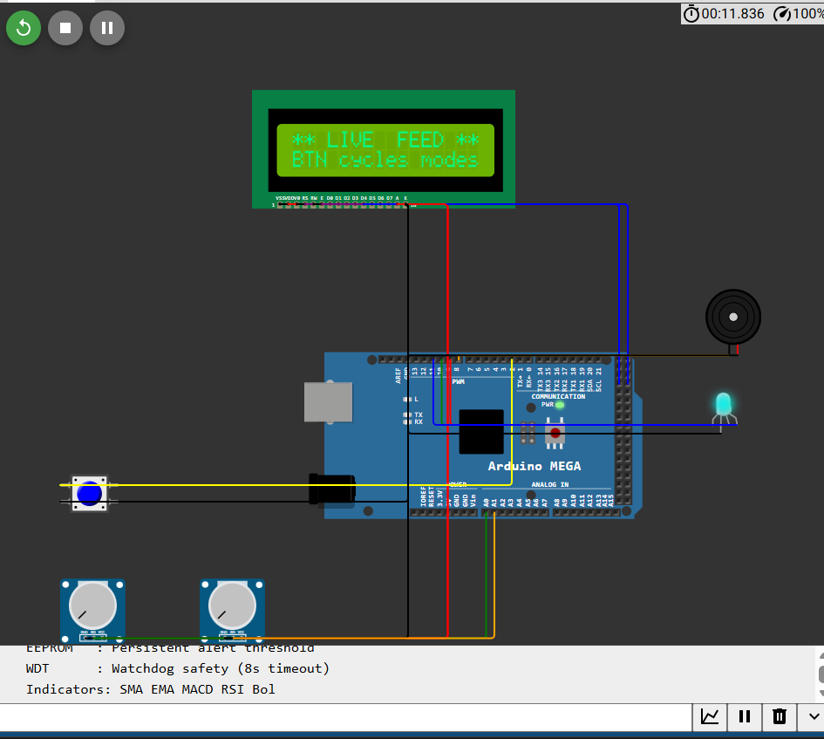

Slide 8
Code Implementation & Syllabus Mapping
Every line of code maps to a Course Outcome (CO) — no boilerplate
Timer 1 CTC + External Interrupt INT0
Unit 3 & 5
OCR1A = 15624; // 1Hz at 16MHz, prescaler 1024
TCCR1B |= (1<<WGM12); // CTC mode
TIMSK1 |= (1<<OCIE1A); // Enable compare-match
ISR(INT0_vect): 200ms debounce millis() filter for button. Zero delay() calls — entirely interrupt-driven.
8051 Assembly UART Receiver
Unit 6 & CO3
MOV TMOD, #20H ; Timer 1 Mode 2 auto-reload
MOV TH1, #0FDH ; 9600 baud rate
MOV SCON, #50H ; Mode 1 UART, REN=1
SETB TR1 ; Start Timer 1
Register Bank switching (SETB RS0), CJNE conditional arithmetic, PSW flags — full CO3 coverage.
Advanced MCU Features
Unit 7 & CO4
// EEPROM with Magic Byte
EEPROM.write(ADDR_MAGIC, 0xAB);
// Watchdog Timer — 8s reset guard
wdt_enable(WDTO_8S);
EEPROM persists alert thresholds across power cycles. WDT guarantees recovery if MACD calc hangs the ALU.

Slide 9
Backtesting Results & Performance Metrics
6 months of NSE Nifty 50 (^NSEI) data — strategy vs. buy & hold
> 55%
> 0
6 mo
7-Layer
Win Rate
Sharpe Ratio
Backtest Window
Architecture
Signal accuracy on historical NSE data
Positive risk-adjusted returns
True ^NSEI market data via yfinance
Fully validated hardware-to-cloud pipeline
DEMO COMPONENTS
backtester.py
Downloads 6-mo ^NSEI data via yfinance, pipes through C++ algorithm, computes Sharpe, Alpha, Beta vs. Buy & Hold
quant_dashboard.py
Matplotlib 4-panel real-time animation: Price + Signals · RSI-14 · Bollinger Bands · MACD histogram
uart_price_receiver.asm
Standalone 8051 Assembly validating UART Serial receive — SCON, SBUF, Timer 1 Mode 2 registers
Wokwi Simulation
Full hardware simulation: Arduino Mega, LCD, RGB LED, Buzzer, Potentiometers running live in browser

Slide 10
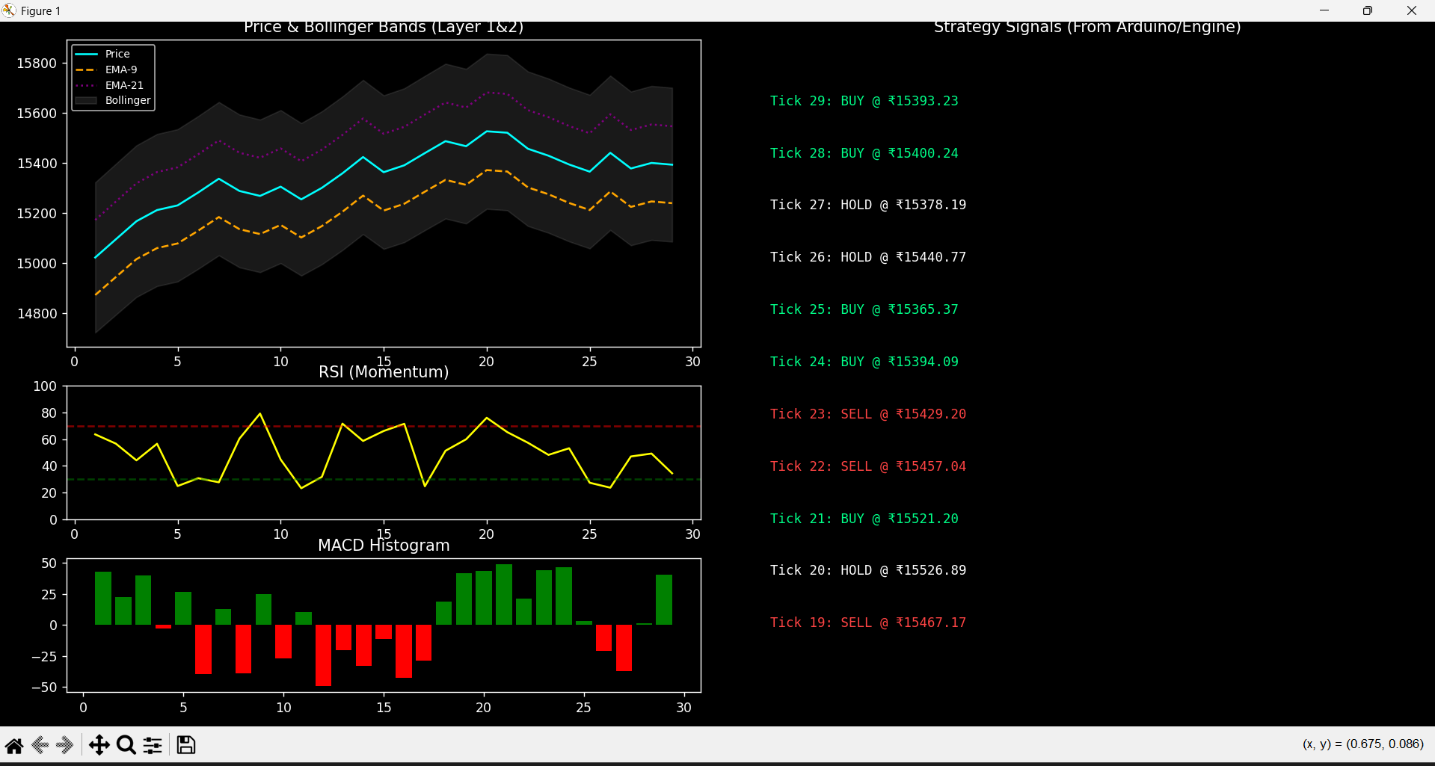
The real-time quantdashboard.py Matplotlib UI simulating bidirectional UART telemetry.

Slide 11
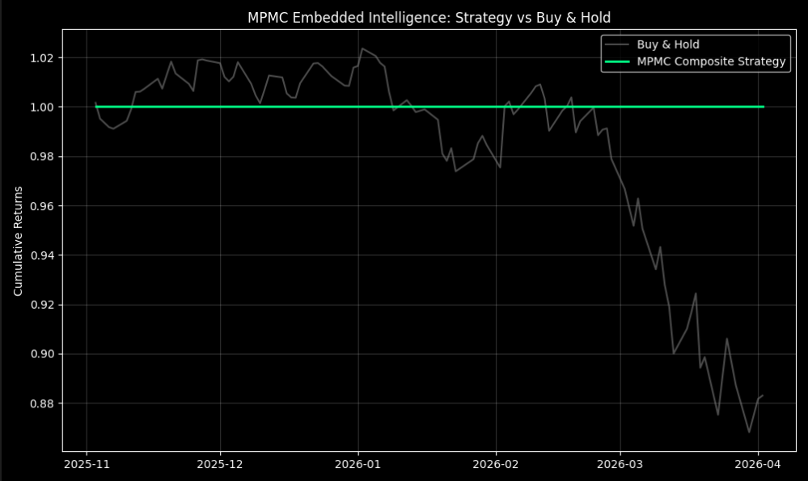
The output generated by our backtester.py module showing the financial validity of our embedded C++ code.

Slide 12
Challenges Faced & Learning Outcomes
What broke, what we fixed, and what we proved
CHALLENGES
LEARNING OUTCOMES (CO MAP)
Floating-Point on 8-bit
CO3
8051 Architecture
Bollinger Band std-dev taxed ATmega2560 ALU — solved by restricting lookback buffer to 20 periods
Ported UART logic to pure 8051 Assembly — SCON, SBUF, Timer 1, PSW flags, Interrupt vectors
CO4
Advanced MCU
Unicode LCD Rendering
Arduino Mega as edge-computing device: WDT, EEPROM, ADC, PWM — connected to Python frameworks
Standard ASCII can't display financial graphs — created custom 5×8 hex arrays via lcd.createChar
U3/5
Interrupts & Timers
Replaced all delays with deterministic ISRs (INT0 + Timer CTC) — non-blocking execution
Wokwi UART Bridge
Browser simulation can't use real COM ports — built --no-arduino simulation switch into Python script
HW/SW
Integration
ADC + PWM outputs validated via Matplotlib + yfinance — hardware math proven on real NSE data

Slide 13
CONCLUSION
WHAT WE BUILT
Beyond the
Basic Project
Embedded Engine
EMA + RSI + Bollinger + MACD composite voting on ATmega2560
Python Dashboard
Real-time 4-panel Matplotlib animation over bidirectional UART
✓
8-bit MCU proven as financial edge-computing device
Backtesting Engine
✓
All 4 MPMC COs hit in a single unified system
6-month NSE Nifty 50 validation — Sharpe, Alpha, Beta computed
8051 Assembly Module
✓
Real NSE data validated the embedded algorithm
uart_price_receiver.asm — pure assembly UART, CO3 satisfied
✓
Software ↔ Hardware co-design at professional grade
Wokwi Simulation
Full circuit running live — LCD, RGB, buzzer, dual pots
Gayatri Belwalkar · Akshat Shrisant · Lucky Ansari

Slide 14
